Slide 1
Recent Trends in Asia & Oceania
Cody Williams

Slide 2
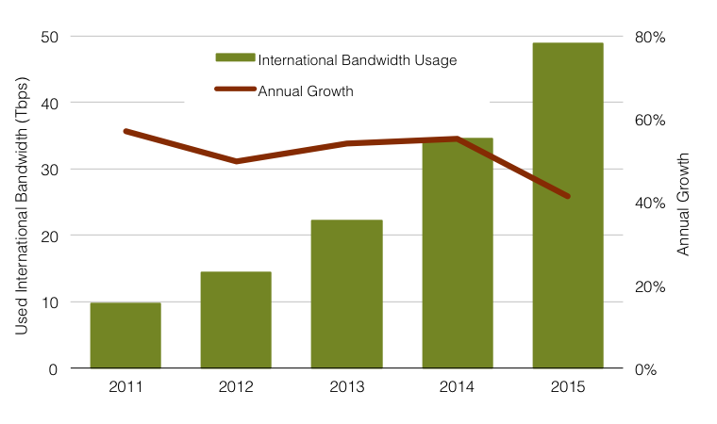
Overall Bandwidth Growth in Asia
Notes:
Growth in Asia (overall) has been pretty strong, but some dropoff for this year. This trend is not limited to Asia, most other regions have seen similar declines. But current levels stlll have bandwidth doubling every 2 years.

Slide 3
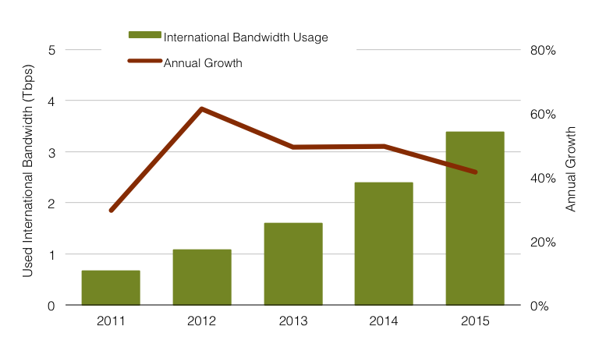
Overall Bandwidth Growth in Oceania
Notes:
We see the same decline in Oceania. Both had >50% in previous years. Note the dramatic difference in scale here too. In Asia, nearly 50 Tbps. Oceania, only 3.5. This huge difference in scale drives some of the talk about new cables (and if they are commercially feasable).

Slide 4
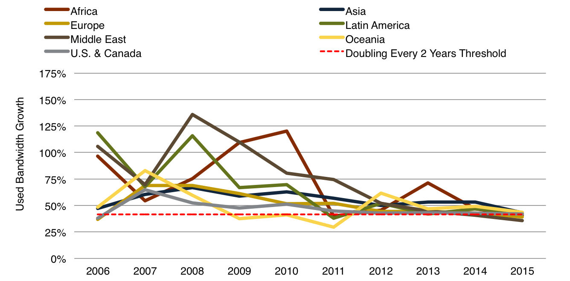
Comparing Growth by Region
Annual Growth in International Used Bandwidth, 2006-2015
Notes:
Asia and Oceania near the top in growth for 2015, but has become much more jumbled than in years past. In some ways you can see bottlenecks disappearing from the map, with the huge jump in growth as new systems came online in the Middle East and Africa. More developed regions like U.S and Canada, Europe, and Asia had more uniform growth. And although Asia has many developing (network wise) countries, they are overshadowed by the huge bw numbers to the hubs – SG, Japan, HK, so you don’t see their rapid growth here.

Slide 5
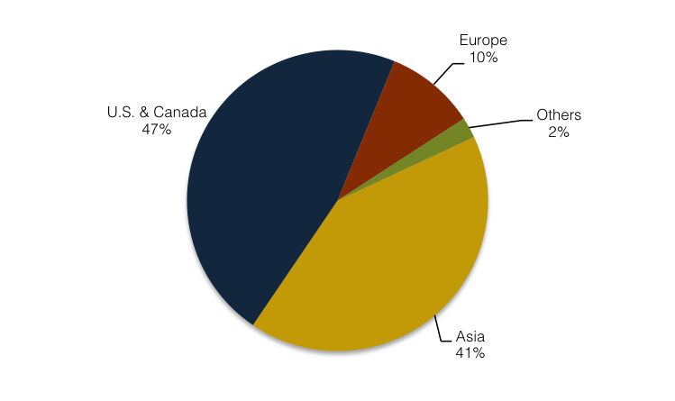
How Asia Bandwidth is Connected
Asia Used Bandwidth Connected by Region, 2015
Notes:
Connectivity to Asia has changed – moving away from the US and more towards intra-Asia as content has moved in the region. Except for Latin America, most other regions connectivity has shifted away from the US. But, that being said, (next slide)

Slide 6
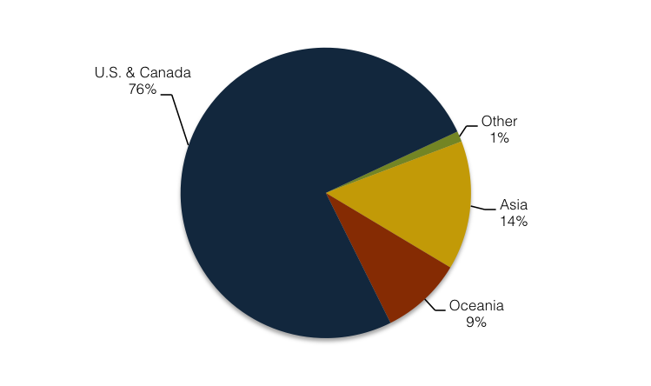
How Oceania is Connected
Oceania Used Bandwidth Connected by Region, 2015
Notes:
Oceania is still very much US facing. With so much connectivity directly to the US, or the US via Guam, not terribly surprising. Especially with how small, relatively speaking, SMW3 is to Sg. When it is in service.

Slide 7
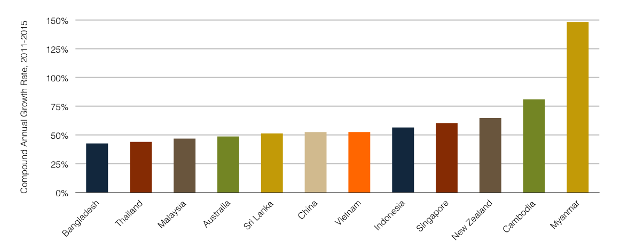
Examining Growth by Country
Compound Annual Growth Rate, Used Bandwidth 2011-2015
Notes:
Growth rates for used bandwidth the last five years. Singapore is the outlier here in that it is both large and growing quickly as it continues to evolve as a hub. Most other countries are very small in overall bandwidth requirements. New Zealand has also grown quickly, as several carriers expanded their international networks.

Slide 8
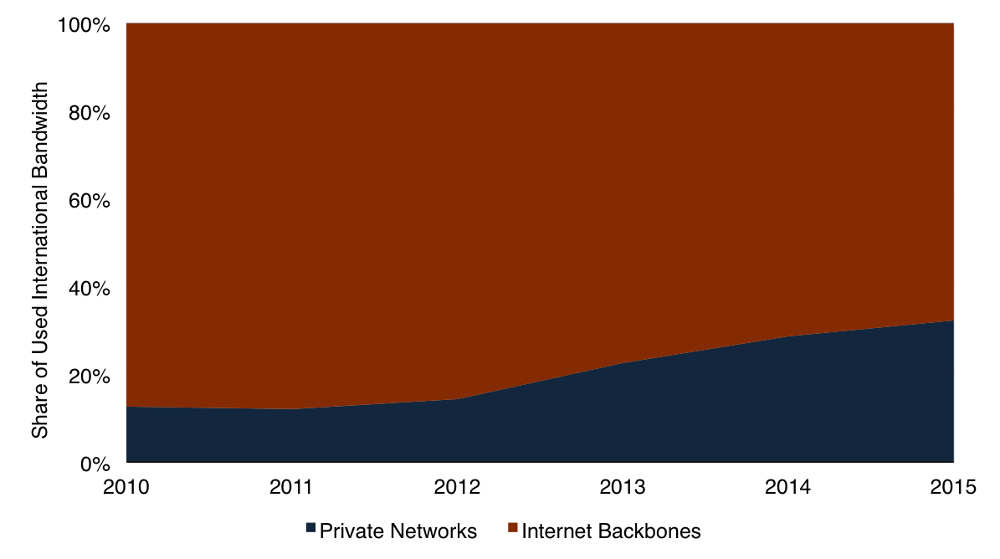
Continued Rise of Private Networks
Used Bandwidth On The Trans-Pacific Route, 2010-2015
32%
Notes:
Growth is coming mostly from private networks, such as Google, Microsoft, Amazon, Apple, and others. While total used bandwidth for both private networks and Internet have grown, private networks are an increasing share of that total. For Year End 2015, private networks constituted 32% of total used bandwidth.

Slide 9
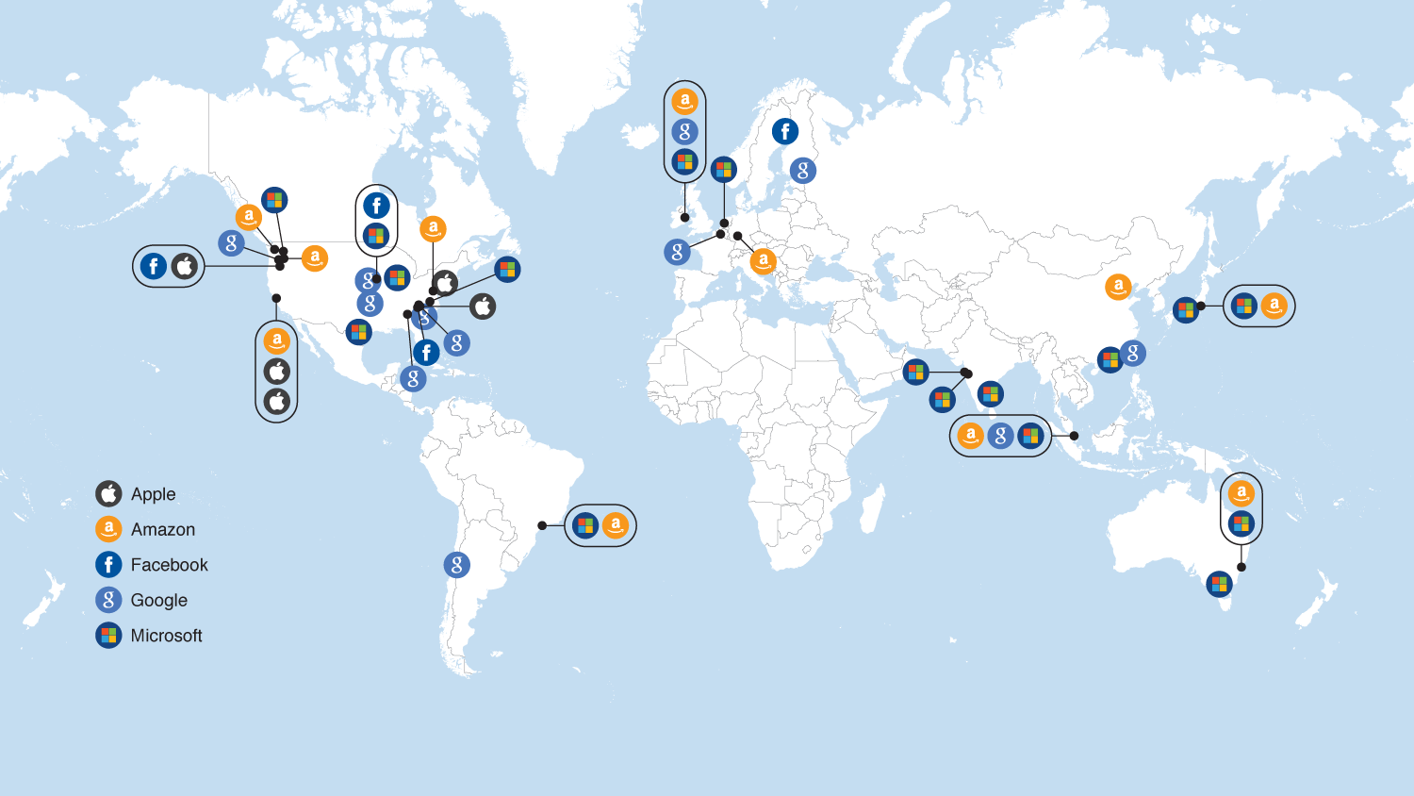
Locations of Major Data Centers, 2015
Notes:
Networks need to connect important data centers. Increasingly, data centers are being built based on power costs and other factors, such as taxation. This has led to data centers being built in rural Oregon, USA and Ireland, and created a demand to connect these data centers to the world.

Slide 10
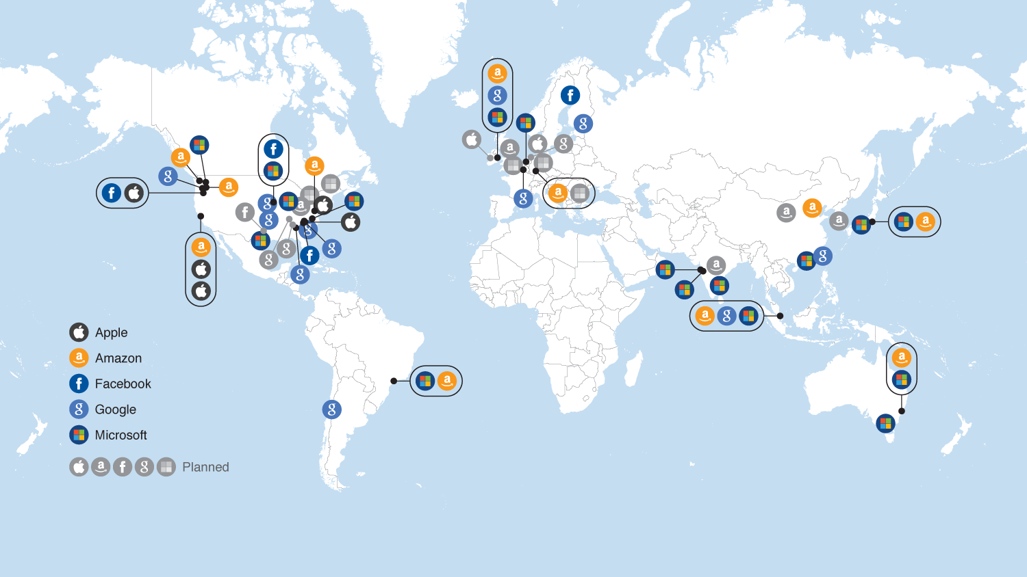
Locations of Major Data Centers, 2017
Notes:
In the next 2 years, more data centers. Many in familiar places – US and Western Europe. But notable new DCs in South Korea, China and India by Amazon.

Slide 11
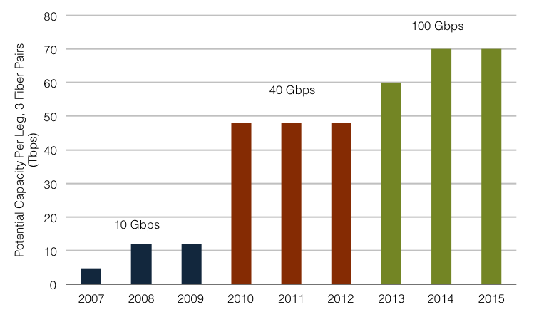
The Move To 100 Gbps Wavelengths
Potential Capacity, Southern Cross North Leg (Tbps)
Notes:
And in order to meet the demand for bandwidth, technology has expanded from 10Gbps wavelength technology to 40G and quickly from there to 100G. And to illustrate this, lets look at Southern Cross, connecting us here in Auckland to the US mainland. SX is also an interesting one to examine, since their long spans make adaptations of new technology more challenging than some other shorter systems.

Slide 12
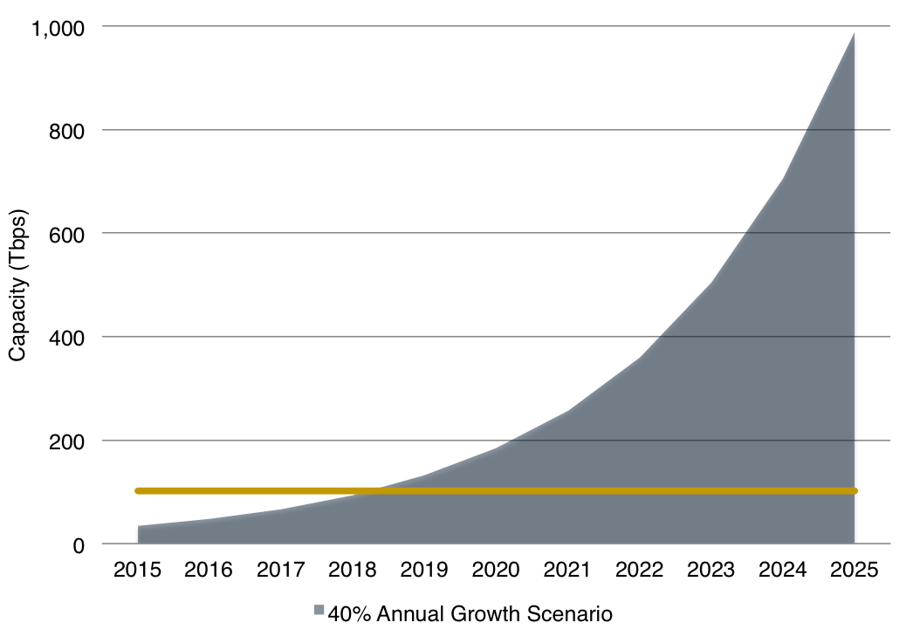
But What About The Future?
Lit and Potential Trans-Pacific Capacity 2015-2025
Potential of existing cables 2015
Exhaustion in mid-2018
Notes:
Let’s put on our alarmist hats for a minute. What are we going to do to meet future demand? Here is where we are at now, and if technology gets frozen in time. Exhaustion is only 2.5 years away!

Slide 13
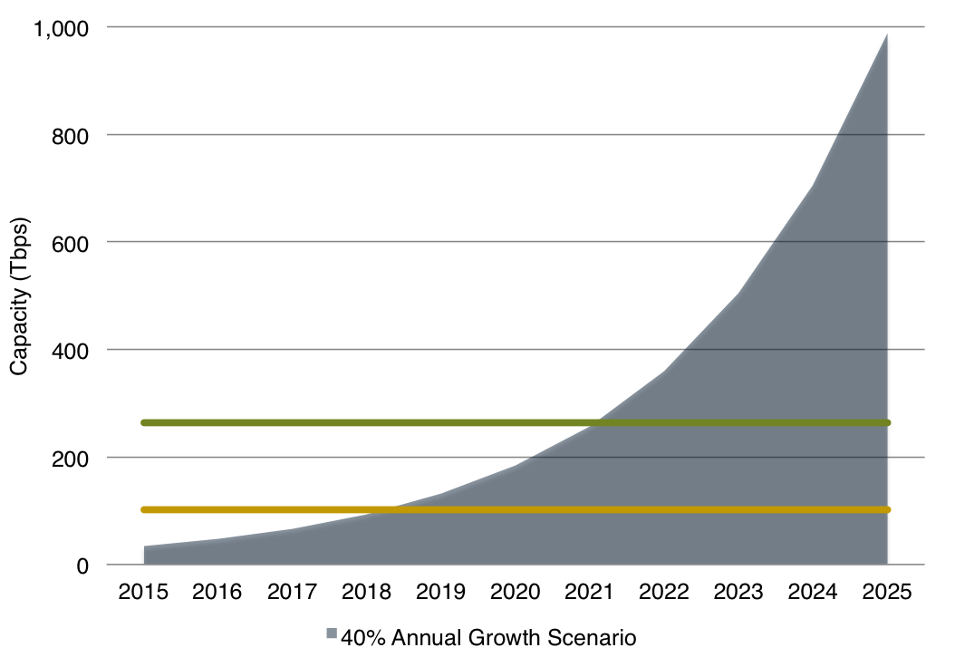
Capacity Exhaustion Continued
Lit and Potential Trans-Pacific Capacity 2015-2025
Potential of existing cables plus
FASTER, SEA-US, & NCP
Exhaustion in 2021
Notes:
Ok, well we do have some newwer systems coming. What will they do? Ok, now we’re at 2012, but that’s just around the corner in planning terms. 5 years! It takes a long time under the best circumstances to build a new system. For example, NCP will be under construction for two years!

Slide 14
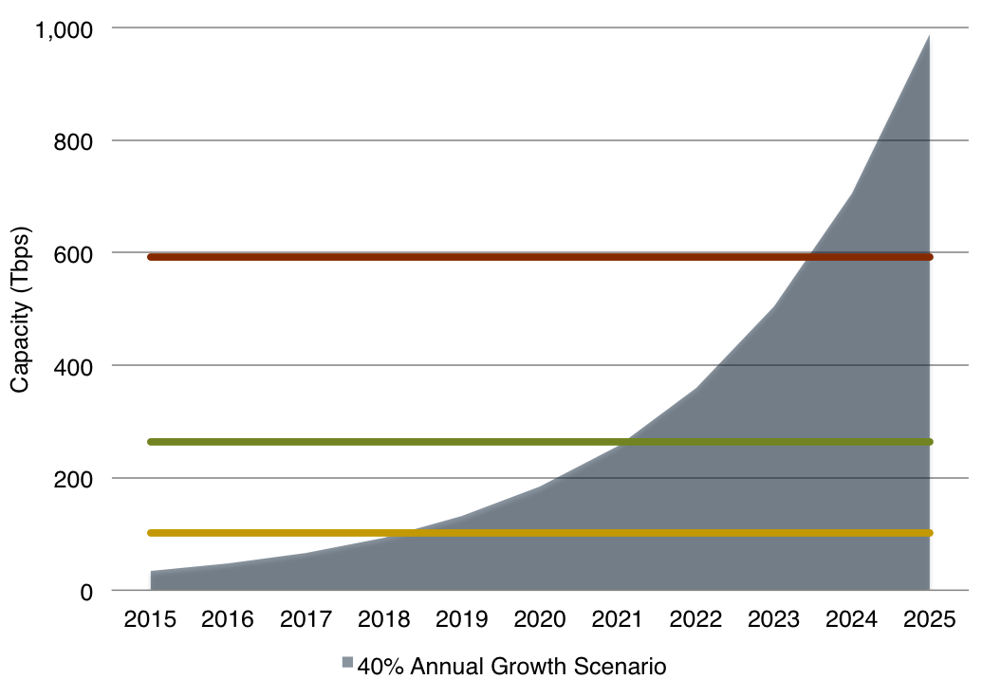
Capacity Exhaustion Continued
Lit and Potential Trans-Pacific Capacity 2015-2025
Potential if all older cables could theoretically accommodate 100 x 100G
Exhaustion in 2023
Notes:
Ok, let’s unfreeze technology. What if we can upgrade all the older cables to 100 x 100. We’re already seeing 130 x 100 in new cables, and the latest 100G equipment gets better and better on squeezing out capacity on the old systems. Now we’re at least 7 years out.

Slide 15
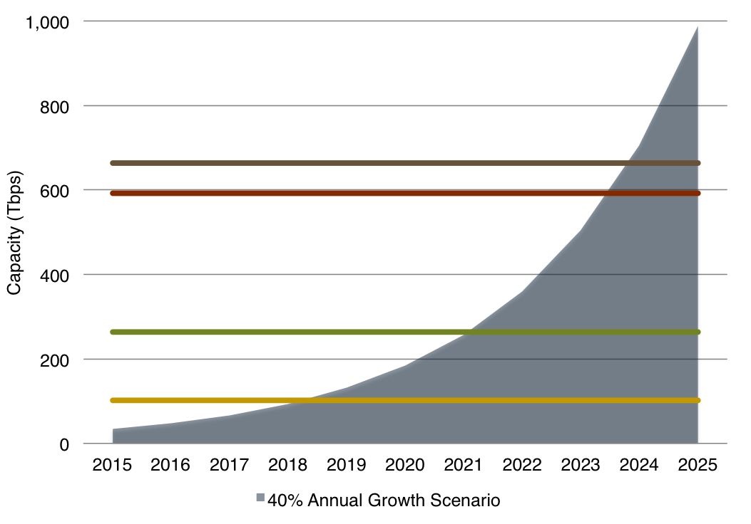
Capacity Exhaustion Continued
Lit and Potential Trans-Pacific Capacity 2015-2025
Potential with adding 1 new 72 Tbps cable
Exhaustion in mid-2023
Notes:
Ok, now if we had a new system, and a fairly big one at 72T. For comparison, the 7 pair’d NCP is expected to have a potential of 83T, we only get SIX MONTHS further than just existing systems.
But ok, let’s take our alarmist hats off now. What do we know? Upgrades will get better – we’re around the corner from superchannels and 200 Gbps, 400 Gbps, and 1T wavelengths (though we many hit the Shannon limit for trans-pac around 400G) so that will be able to meet some of the demand. Also, we know that new cables will get built when the need is there. NCP wont be the last trans-pac cable built. But it will take BOTH to meet the demand. Upgrades have been the overwhelming source for new capacity the last five years, but that may not be the case forever.

Slide 16
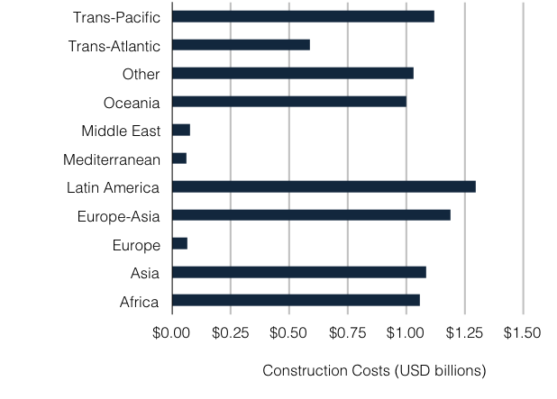
And A Snapshot Of Spending On Cables, 2015-17
Notes:
Carriers and consortiums are spending lots of money on new cables in the near future. Over 1B each in Asia, Oceania, and the Pacific. All kinds of different projects, with many proposed cables to link smaller nations in Oceania via cable for the first time, to long haul trans-pac cables.

Slide 17
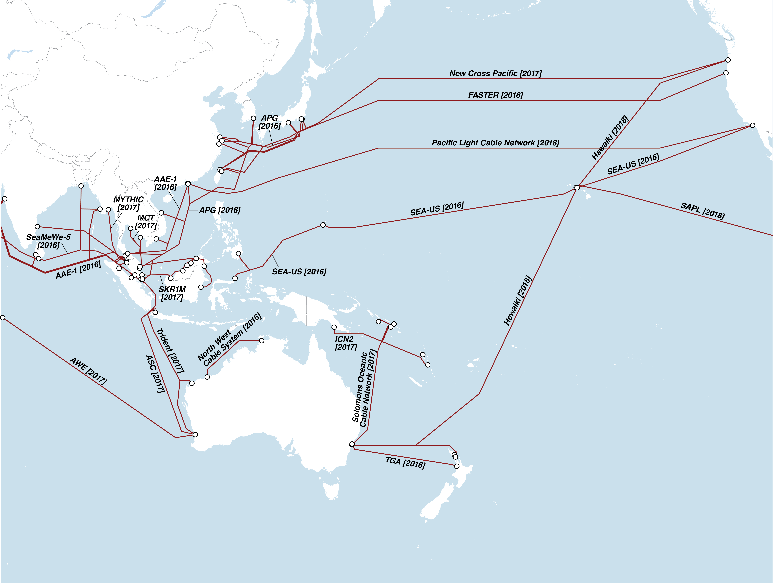
Proposed Cables, 2016-2018
Notes:
And a visual representation of what is going on in Asia. Of course, keep in mind that not all of these will get built, and not all those dollars I just listed will be spent. And beyond these, there are plenty of ideas that haven’t become announced projects yet.

Slide 18
Prices Still Falling
Median Monthly Lease, 10 Gbps Wavelength
Notes:
Now, on to pricing. I’m showing median prices here on the figures, but will share our low prices as we go along. Prices go one way – down – the question is just how fast they are declining. Compared to Lon-NY, most routes have experienced more rapid decline. Connectivity to India is the exception here.

Slide 19
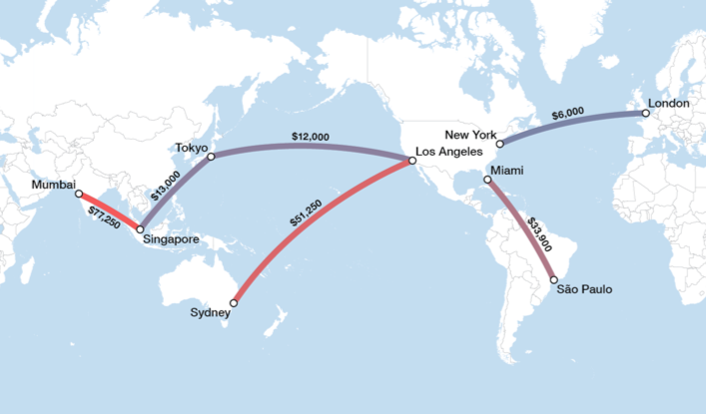
Prices Vary By Geography
Median Lease Price, 10 Gbps wavelength, Q4 2015.
Notes:
And there is variation all over the world. Trans-Pac and Intra-Asia prices have come down quite a bit over the last handful of years. Compariatively, capacity to Australia and NZ and to India is expensive.

Slide 20
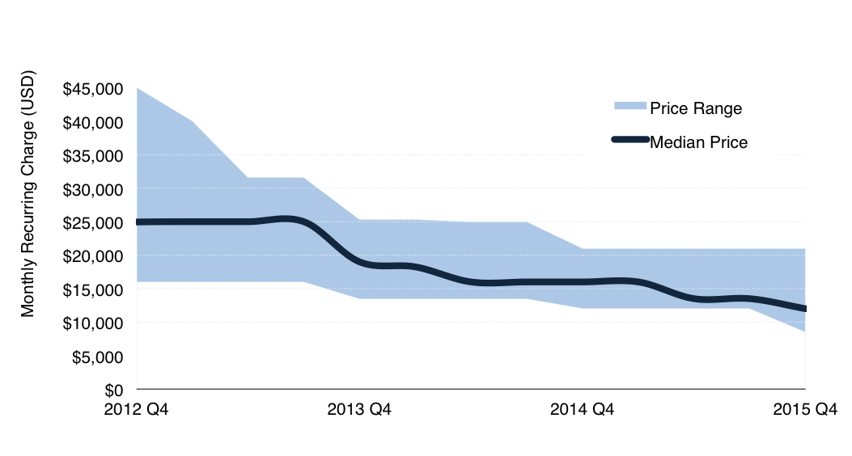
And By Carrier
Median & Price Range for 10 Gbps on Los Angeles-Tokyo, 2012-2015
Notes:
Prices can range a lot by carrier too. On a big route like trans-pacific, the median is closer to the low end, at least right now, but carriers are still all over the place. Some are competing in the open market, while some try to just sell to captured (likely domestic) markets.

Slide 21
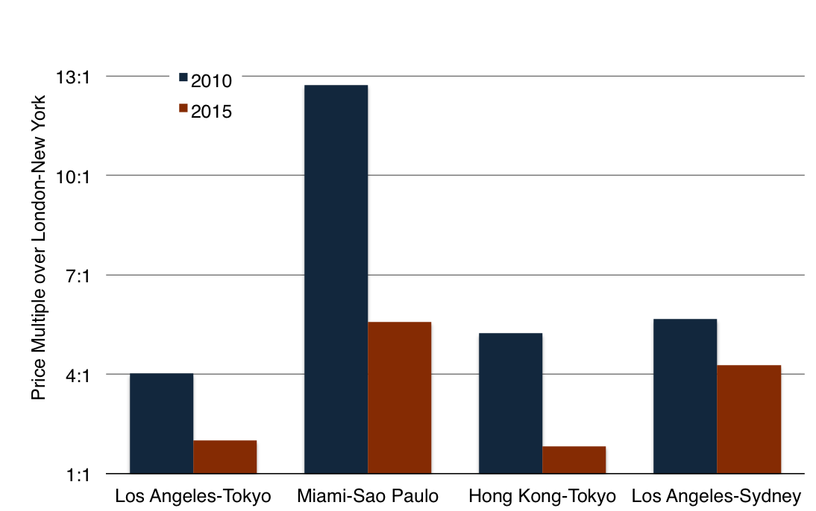
Transport Price Differences Narrowing
10 Gbps Wavelength Lease Price Multiples over London-New York
Notes:
The Trans-Atlantic route offers some of the lowest prices for long haul capacity, and it is helpful to look at other routes in comparison to his one, since there are a multitude of both cables and carriers that can sell capacity. Pricing on T_A has less meat on the bones than others too – card costs and other factors are similar for all cables. So as time has gone on, we’ve seen some convergence to T-A pricing. And if you really want to hear more about this, check out my talk at last year’s APRICOT. Most interestingly, LA-Sydney has converged the least. Now, it should be noted that in absolute dollar terms, the price has fallen $200,000 USD for each 10 Gbps wave, but comparatively, it hasn’t converged as much as other large routes have.

Slide 22
Overall Conclusions
Demand remains strong, 43% growth between 2014 and 2015 for Asia and Oceania.
Private Network demand continues to grow, 61% on the Trans-Pacific route between 2014 and 2015.
Price variance narrowing on many routes, with multiples of the London-New York route narrowing.
We’ll need more cables, increases in optical transmission technology, or likely both to meet future demand.

Slide 23
Thank You!
Cody Williams
C: 1.571.213.6788
cwilliams@telegeography.com

